Slide 1
PRESIDENCY UNIVERISTY, BENGALURU, School of Engineering
Computer Organization and Architecture
CSE 2009
Module-1: Basic Structure of Computers

Slide 2
Computer:
It is fast electronic device that accepts digitized input information, processes it according to a list of internally stored instructions and produces the resulting output information.
Computer program:
The list of instructions that performs the task is called a computer program.

Slide 3
Types of Computers
Computers are classified based on size, cost and computational power.
Microcomputers
Mainframes
Minicomputers
Servers
Super computers

Slide 4

Microcomputer
The most common computer is microcomputer.
e.g. Desktop computer.
Microcomputers are designed to be used by individuals, whether in the form of PCs, workstations, or notebook computers.
A Microcomputer contains a CPU on a microchip (the microprocessor).
Desktop computers have processing and storage units, display and audio output units, and keyboard that can all be located easily on a desk.
The storage media includes hard-disks, CD-ROMs.

Slide 5

Laptop Computer
Portable notebook computers are a compact version of the personal computer..
All components (keyboard, mouse, etc.) are in one compact unit.
Usually more expensive than a comparable desktop.
Sometimes called a Notebook.

Slide 6
Workstation
Powerful desktop computer designed for specialized tasks.
It has more computational power than personal computers.
Workstations are often used in engineering applications.
Workstations generally come with a large high-resolution graphics screen.
Most workstations also have mass storage devices such as disk drive, but a special type of workstation, called diskless workstation, comes without a disk drive.
Like personal computers, most workstations are single-user computers.

Slide 7

Mainframe
A very large and expensive computer capable of supporting hundreds or even thousands of users simultaneously.
Mainframes are mainly Used to store, manage, and process large amounts of data.
Mainframes are used in medium to large corporations that require more computing power and storage capacity than workstations can provide.

Slide 8
Minicomputer
A midsized computer, in size and power, minicomputers lie between workstations and mainframes.
A multi-user computer capable of supporting from 10 to hundreds of users simultaneously.
In recent years, the minicomputer has evolved into the “mid-range servers”

Slide 9

Server
Purpose is to “serve.”
A computer that has the purpose of supplying its users with data; usually through the use of a LAN (local area network).

Slide 10
Supercomputer
A Super computers is typically used for scientific and engineering applications that must handle very large databases or do a great amount of computation.
It is used for large- Scale numerical calculations required in applications such as weather forecasting and aircraft design.
super computers are fastest, costliest and most powerful computers.
It can execute million instructions per second.
Most super computers are really multiple computers that perform parallel processing.

Slide 11
Functional Units Of Computer
A computer consists of five functionally independent main parts.
Input unit
Output unit
Memory unit
Arithmetic and logic unit
Control unit

Slide 12
Arithmetic
Input
and
logic
Memory
Output
Control
I/O
Processor
Basic functional units of a computer

Slide 13
How information is handled by computer?
It is convenient to categorize this information as either instructions or data.
Instructions or Machine instructions, are explicit commands that
  govern the transfer of information within a computer as well as between the computer and its I/O devices.
  Specify the arithmetic & logic operations to be performed.
Usually programs (set of instructions) is stored in the memory. Processor then fetches the instructions that make up the program from the memory, one after the another, and performs the desired operations.

Slide 14
Computer is completely controlled by the stored program
Data are numbers and encoded characters that are used as operands by the instructions.

Slide 15
Input Devices
The input unit accepts coded information from users
The information received is either stored in the computer’s memory or immediately executed by the ALU.
The most well-known input device is the key-board.
Whenever key is pressed, the corresponding letter or digit is automatically translated into its corresponding binary code and transmitted over a cable to either the memory or the processor.

Slide 16

Keyboard
An arrangement of letters, numbers, and special function keys that act as the primary input device to the computer.

Slide 17

Mouse
An input device that allows the user to manipulate objects on the screen by moving the device along the surface of a desk.

Slide 18

Output Devices
the output unit is the counterpart of the input unit.
Its function is to send processed results to the outside world.

Slide 19

Speakers
Output devices that receive signals from the computer’s sound card to play music, narration, or sound effects.

Slide 20
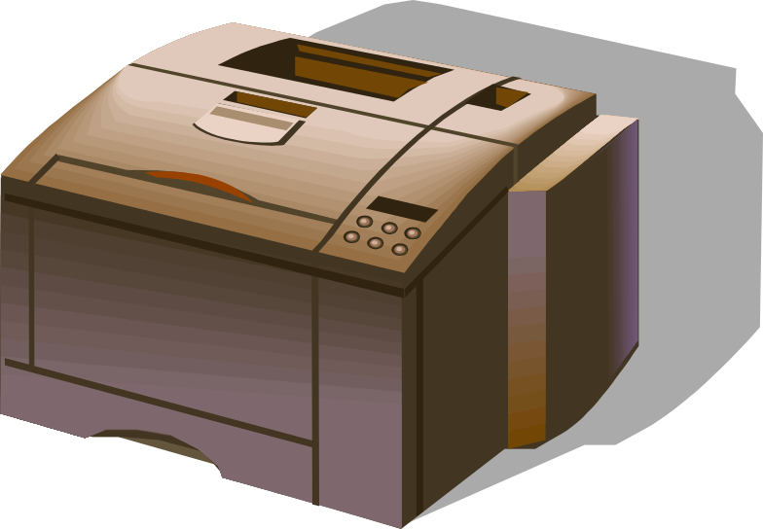
Printer
Output device that produces text or graphical images on paper.

Slide 21

Storage Devices
Used to keep data when the power to the computer is turned off.
Different forms
  Hard disk
  Floppy or zip disks
  CD-Writer

Slide 22
Memory Unit
The function of memory unit is to store the programs and data.
There are two classes of storage
1) Primary Storage
2) Secondary storage
Primary Storage:
It is a fast memory that operates at electronic speeds.
Programs must be stored in the memory while they are being executed.

Slide 23
The memory contains a large number of semiconductor cells, each capable of storing in one bit of information.
Because a single bit represents a very small amount of information, bits are not handled individually.
The memory is organized so that the contents of one word, containing ‘n’ bits can be stored or retrieved in one basic operation.
To provide easy access to any word in the memory, a distinct address is associated in with each word location.
Addresses are numbers that identify successive locations
A word address can be used to access the word.

Slide 24
Word Length:
The number of bits in each word is called as the word length of the computer.
Typical word lengths range from 16-64 bits.
Memory Access Time:
The time required to access one word is called the memory access time.
This time is fixed, independent of the location of the word being accessed.
It typically ranges from a few nanoseconds (ns) to about 100 ns.
The primary memory is also called as main memory.

Slide 25
Primary memories are small in capacities and expensive.
Thus additional, cheaper secondary storage is used when large amounts of data and many programs have to be stored.
Secondary storage devices:
Magnetic disks
Magnetic tapes
CD-ROMs

Slide 26
Arithmetic And Logic Unit
It performs the arithmetic operations such as addition, subtraction, multiplication, division and logic operations such as AND, OR, Not.
Suppose two numbers located in the memory are to be added, they are brought into the processor, and addition is carried out by the ALU .
The SUM may then be stored in the memory.
When the operands are brought into the processor, they are stored in high-speed storage elements called registers.
Each register can store one word of data.

Slide 27
Control Unit
The memory unit, arithmetic and logic and input and output units store and process information and perform input and output operations.
The operation of these units must be coordinated in some way.
Control unit coordinates and controls the activities among the functional units.
It sends the control signals to other units and senses their states.
Data transfers between processor & memory are also controlled by CU through timing signals.
Timing signals are signals that determine when a given action is to take place.

Slide 28
The operation of a computer can be summarized as follows
The computer accepts information in the form of programs and data through an input unit and stores it in the memory.
Information stored in the memory is fetched, under program control, into an arithmetic and logic unit, where it is processed.
Processed information leaves the computer through an output unit.
All activities inside the machine are directed by control unit.

Slide 29
Basic Operational Concepts
Activity in a computer is governed by instructions.
To perform a task, an appropriate program consisting of a list of instructions is stored in the memory.
Individual instructions are brought from the memory into the processor, which executes the specified operations.
Data to be used as operands are also stored in the memory.
e.g. Consider the addition of two operands
Add LOCA, R0
this instruction adds the operand at memory location LOCA to the operand in a register in the processor, and places the sum into register R0.

Slide 30
This instruction requires the performance of several steps
1) the instruction is fetched from the memory into the processor.
2) the operand at LOCA is fetched and added to the contents of R0.
3) Finally, the sum is placed in register R0.
The same task can be performed using two instructions
Load R1, LOCA==load LOCA, R1
Add R0, R1== Add R1,R0
the first instruction transfers the contents of memory location LOCA into the register R1.
Second instruction adds the contents of registers R1 and R0 and places the Sum into R0.

Slide 31
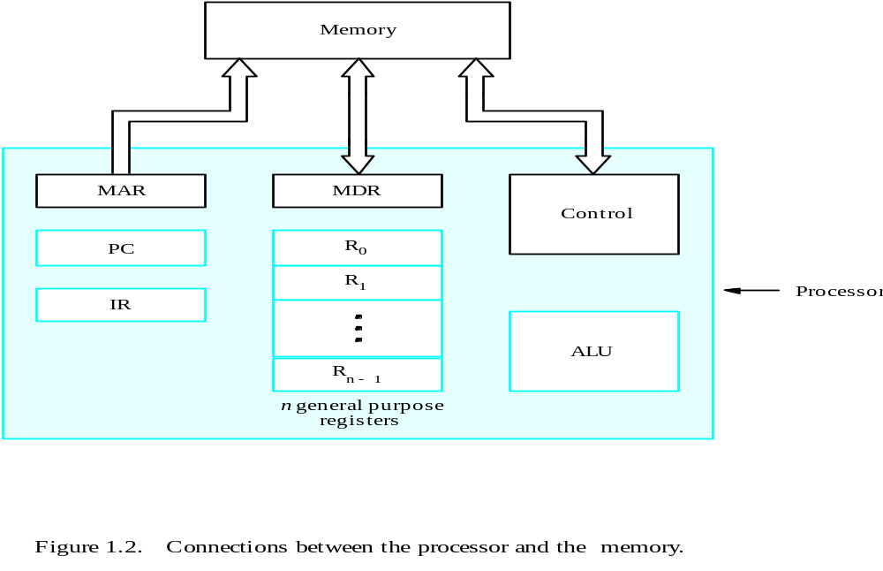
Connection Between the Processor and the memory

Slide 32
Figure shows how the memory and the processor can be connected.
Processor contains number of registers used for several purposes.
Instruction register (IR)
-Holds the instruction that is currently being executed
Program counter (PC)
-Keep tracks of the execution of program
-Contains the memory address of the next instruction to be
fetched and executed
General-purpose register (R₀ – R_{n-1})

Slide 33
MAR & MDR:
These two registers provide communication with the memory.
Memory address Register: (MAR)
It holds the address of the location to be accessed.
Memory Data Register:
It contains the data to be written into or read out of the addressed location.

Slide 34
Operating steps:
Execution of program starts when the PC is set to point to the first instruction of the program.
The contents of the PC are transferred to the MAR and a read control signal is sent to the memory.
After some time, the addressed word is read out of the memory and loaded into the MDR.
Next, the contents of the MDR are transferred to the IR.
Decode and execute the instruction
If the instruction involves an operation to be performed by the ALU, it is necessary to obtain the required operands.

Slide 35
If operand resides in the memory it has to be fetched by sending its address to the MAR and initiates read cycle.
Get operands for ALU
  Operand in general-purpose register
  Operand resides in Memory (Send its address to MAR – Read cycle – transfer from MDR to ALU)
Perform desired operation in ALU
Store the result back to memory
  To general-purpose register
  To memory (address to MAR, result to MDR – Write cycle)
At some point during the execution of the current instruction , the contents of the PC are incremented so that PC points to the next instruction to be executed.

Slide 36
Bus Structures
So far we have discussed the functions of individual parts of a computer.
To form an operational system. These parts must be connected in some organized way.
A group of lines that serves as a connecting path for several devices is called a BUS.
Bus contains three sets of lines
Data lines ( Data Bus)
Address lines (Address Bus )
control lines. (Control Bus)

Slide 37
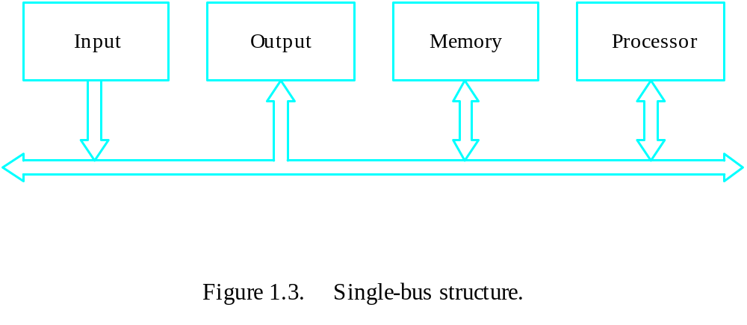
Bus Structure
The simplest way to interconnect functional units is to use a single bus as shown in the above figure

Slide 38
Bus Structure
All units are connected to this bus.
Because bus can be used for only one transfer at a time, only two units can actively use the bus at any given time.
The advantage of the single bus-structure is its low cost and its flexibility for attaching peripheral devices.
multiple buses can be used to interconnect large number of devices.
The devices connected to bus vary widely in their speed of operation, some devices such as keyboards and printers are relatively slow.

Slide 39
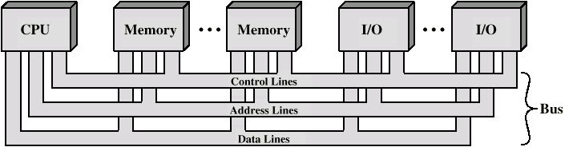
Bus Structure
Memory and processor operate at high speeds.
To synchronize the speeds of these devices.
A common approach is to include buffer registers with the devices to hold the information during transfers.

Slide 40
Performance of a computer
The most important measure of a computer is how quickly it can execute the programs.
The speed with which a computer executes the program is affected by the design of its hardware and its machine language instructions.
Performance of a computer is also affected by the compiler.
For the best performance, it is necessary to design the compiler, the machine instruction set, and the hardware in a coordinated way.

Slide 41
So, the total time required to execute the program is affected by
  Speed of the processor
  Compiler speed
  Disk used
  Speed of output device
The time needed to execute a instruction is called as processor time.
Processor time depends on the hardware involved in the execution of individual machine instructions.
This hardware comprises the processor & the memory which are usually connected by the bus. (diagram in next slide)

Slide 42
Performance of a computer
Main
Cache
memory
memory
Processor
Bus
The processor cache.

Slide 43
A program will be executed faster if the movement of instructions and data between the main memory is minimized.
For example, suppose a number of instructions are executed repeatedly over short period of time, as happens in the program loop.
If these instructions are available in the cache memory, they can be fetched quickly during the period of repeated use.

Slide 44
Processor clock
Each & every electronic embedded systems should have processor circuit.
These Processor circuits are controlled by a timing signal called clock.
The clock defines regular time intervals, called clock cycles.
Each & every machine instruction is having one or more actions. For ex, add R0,R1
To execute a machine instruction, the processor divides the action to be performed into sequence of basic steps, such as each step to be completed in one clock cycle.
So clock cycle is an important parameter that affects processor performance.
The ‘p’ be the length of one clock cycle.
clock rate is given by R=1/ P, which is measured in cycles per second.
Generally, processor speed is mentioned in terms of clock rates & it is in some Giga hertz (G Hz)

Slide 45
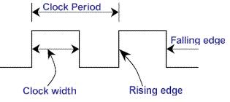

Slide 46
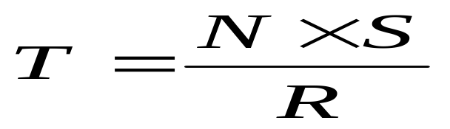
Basic Performance Equation
T –time taken by the processor to execute the program written in high-level language
N – number of actual machine language instructions in the program (needed to
complete the execution (note: loop)
S – average number of basic steps needed to execute one machine
instruction. Each step completes in one clock cycle
R – clock rate
Note: these are not independent to each other

Slide 47
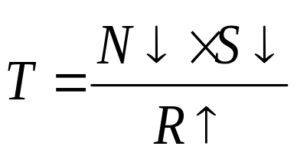
Basic Performance Equation
How to improve the performance parameter T?
Solution: To achieve high performance. The computer designer must reduce the value of T, which means reducing N, & S and increasing R
The value of ‘N’ is reduced if the source program is compiled into fewer machine instructions.
The value of ‘S’ is reduced if instructions have a smaller number of basic steps to perform.
Using higher- frequency clock increases the value of ‘R’. which means that the time required to complete a basic execution step is reduced.

Slide 48
Possibilities for increasing the clock rate
1.Improving the integrating –circuit (IC) technology makes logic circuits faster, which reduces the time needed to complete a basic step. this allows the clock period ‘p’ to be reduced and the clock rate ’R’ to be increased.
2. Reducing the amount of processing done in one basic step also makes it possible to reduce the clock period.

Slide 49
Number Representation
Computers are built using logic circuits that operate on information represented by two valued electrical signals. We label the two values as 0 and 1.
The most natural way to represent a number in a computer system is by string of bits, called binary number.
A text character can also be represented by a string of bits called character code.

Slide 50
We obviously need to represent both positive and negative numbers.
Three systems are used for representing such numbers.
1. Sign- and –magnitude.
2. 1’ s Complement.
3. 2’s Complement.
In all three systems, the left most bit is 0 for positive numbers and 1 for negative numbers.
Positive values have identical representations in all three systems, but negative values have different representations.

Slide 51
Sign- and - magnitude:
In sign and magnitude system, negative values are represented by changing the most significant bit from 0 to 1 in the b vector of the corresponding positive value.
For example +5 is represented by 0101, and -5 is represented by 1101.
1’s complement:
In 1’s complement representation, negative values are obtained by complementing each bit of the corresponding positive value.
Thus, the representation for -3 is obtained by complementing each bit in the vector 0011 to get 1100.

Slide 52
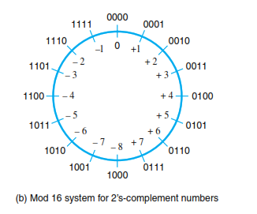
2’ s complement :
In 2’s complement, negative values are obtained by adding 1 to the 1’s complement of that number.
2’s complement is the most efficient way to carry out addition and subtraction operations.
It is one most often used in computers.

Slide 53
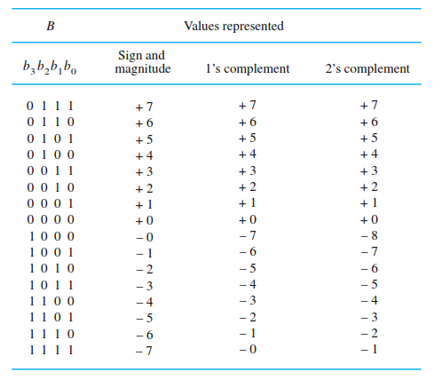

Slide 54
Addition and subtraction of signed numbers
Addition:
To add two signed numbers , add their n- bit representations , ignoring the carry-out signal from the most significant bit (MSB) position.
The sum will be algebraically correct value in the 2’s complement representation as long as the answer is in the range -2^{n-1} through +2^{n-1} -1.

Slide 55
Subtraction of signed numbers:
To subtract two numbers X and Y, that is to perform X-Y, form the 2’s complement of Y and then add it to X, the result will be the algebraically correct value in the 2’s complement representation system if the answer is in the range
-2^{n-1} through +2^{n-1}-1.

Slide 56
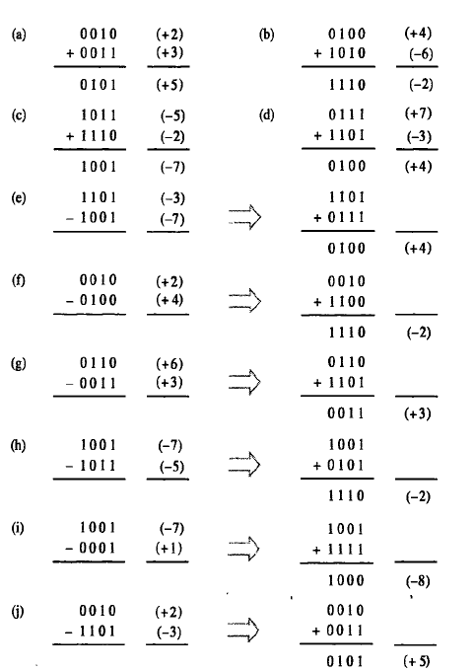
Examples:

Slide 57
Overflow in integer arithmetic
In the 2’s complement number representation system, n bits can represent values in the range -2^{n-1} through +2^{n-1}-1. for example, using four bits, the range of numbers that can represented is -8 through +7.
When the result of an arithmetic operation is outside regrettable range, an overflow has occurred.
For example, when using 4- bit signed numbers, if we try to add the numbers +7 and +4, the output sum vector , S, is 1011. which is code for -5, an incorrect result.
Similarly, if we try to ad -4 and -6, we get S= 0110= +6, another incorrect result
Thus , overflow may occur if both summands have the same sign.

Slide 58
A simple way to detect overflow is to examine the signs of the two summands X and Y and the sign of the result. When both operands X and Y have the same sign, an overflow occurs when the sign of S is not the same as the signs of X and Y.
Characters :
In addition to numbers computers must be able to handle nonnumeric text information consisting of characters. Characters can be letters of the alphabet, punctuation marks, and so on.
They are represented by codes that usually eight bits long.
One of the most widely used codes is the American Standards Code for Information Interchange (ASCII).

Slide 59
Memory Locations and Addresses
n
bits
first word
How the memory is organized?
Memory consists of many millions of storage cells, each of which can store 1 bit.
Data is usually accessed in n-bit groups. n is called word length.
second word
•
•
•
th word
i
•
•
•
last word
Memory words.

Slide 60
Memory Locations and Addresses
32-bit word length example
32 bits
•
•
•
b
31
b
30
b
1
b
0
Sign bit:
b
31
=
0
for positive numbers
b
31
=
1
for negative numbers
(a) A signed integer
8 bits
8 bits
8 bits
8 bits
ASCII
ASCII
ASCII
ASCII
character
character
character
character

Slide 61
Memory Locations and Addresses
To retrieve information from memory, either for one word or one byte (8-bit), addresses for each location are needed.
A k-bit address memory has 2^{k} memory locations using numbers from 0 – 2^{k}-1 as the addresses of successive locations in the memory.
2^{k} addresses constitute the address space of the computer.
24-bit memory: 2²⁴ = 16,777,216 = 16M (1M=2²⁰)
32-bit memory: 2³² = 4G (1G=2³⁰)
1K(kilo)=2¹⁰ 1T(tera)=2⁴⁰
Notes:
MITE

Slide 62
Memory Locations and Addresses
Byte Addressability
It is impractical to assign distinct addresses to individual bit locations in the memory.
The most practical assignment is to have successive addresses refer to successive byte locations in the memory – byte-addressable memory.
Byte locations have addresses 0, 1, 2, … If the word length is 32 bits, successive words are located at addresses 0, 4, 8,…
Notes:
MITE

Slide 63
Big-Endian and Little-Endian Assignments
Big-Endian: Lower byte addresses are used for the most significant bytes of the word
Little-Endian: Lower byte addresses are used for the less significant bytes of the word
W
ord
address
Byte address
Byte address
0
0
1
2
3
0
3
2
1
0
4
4
5
6
7
4
7
6
5
4
•
•
•
•
•
•
2
k
-
4
2
k
-
4
2
k
-
3
2
k
-
2
2
k
-
1
2
k
-
4
2
k
-
1
2
k
-
2
2
k
-
3
2
k
-
4
(a) Big-endian assignment
(b) Little-endian assignment
Byte and word addressing.
Notes:
MITE

Slide 64
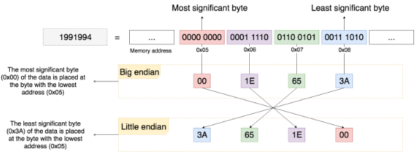
Big-Endian and Little-Endian Assignments

Slide 65
Memory Locations and Addresses
Word Alignment
Words are said to be aligned in memory if they begin at a byte address. that is a multiple of the num of bytes in a word.
    16-bit word: word addresses: 0, 2, 4,….
    32-bit word: word addresses: 0, 4, 8,….
    64-bit word: word addresses: 0, 8,16,….
Access numbers, characters, and character strings
Notes:
MITE

Slide 66
Memory Operation
Load (or Read or Fetch)
Transfers a copy of the contents of a specific memory location to the processor.
The memory content doesn’t change.
Processor send the address of the desired location to the memory and request its contents to be read.
The memory reads the data and send them to the processor.
Store (or Write)
Transfers an item of information from the processor to a specific memory location.
The former contents of that location is overwritten.
The processor sends the address of the desired location to the memory along with the data to be written.
Notes:
MITE

Slide 67
Instruction and Instruction Sequencing
We know that, program is nothing but an collection of instructions.
These instructions may be addition of 2 numbers(some arithmetic operations), testing for a particular condition(logical operation), reading a character/data from the input device, sending a character to be displayed on the output device.
So the small steps may be one of these

Slide 68
Instruction and Instruction Sequencing
Every computer must have some instruction set so that can perform 4 types of operations
Data transfers between the memory and the processor registers
Arithmetic and logic operations on data
Program sequencing and control
I/O transfers
Notes:
MITE

Slide 69
Register Transfer Notation
It is nothing but transfer of data from one part of (location) the computer to other part(location)
The possible locations used while transferring data are
  Memory locations
  Processor registers
  Registers in I/O sub-systems
While writing the programs, generally we store the values in a variables. These variables are nothing but the name given to some memory location. It is also known that, every memory location is having an unique address.
Most of the time, we identify a location by some name associated with hardware binary address.
Notes:
MITE

Slide 70
Register Transfer Notation
Identify a location by a symbolic name standing for its hardware binary address
Ex: For memory location: LOC,PLACE,A,VAR2
For processor registers: R0,R1
For I/O registers: DATAIN, OUTSTATUS
Contents of a location are denoted by placing square brackets around the name of the location
Ex: R1←[LOC]
R3 ←[R1]+[R2]
This type of notation is known as Register Transfer Notation (RTN)

Slide 71
Assembly Language Notation
Assembly language notation is another type of notation used to represent machine instructions & programs
Ex: Move LOC, R1 ;R1←[LOC]
Add R1, R2, R3 ;R3 ←[R1]+[R2]
Notes:
MITE

Slide 72
RISC and CISC Instruction Sets
CISC versus RISC
CISC- Complex Instruction Set Computer
RISC- Reduced Instruction Set Computer
CISC | RISC
Instructions can take several clock cycles | Single cycle instructions
Complex and variable length instructions | Simple standardized instructions
Large number of instructions | Small number of fixed length instructions
Many addressing modes | Limited addressing modes

Slide 73
Basic Instruction Types
Three-Address Instructions
  ADD R1, R2, R3 ;R3 ← R1 + R2
  Here, we need 3 words, each for one operand. So, we say it is a 3 address instruction & it is too large to fit in one word.
Two-Address Instructions
  ADD R1, R2 ;R2 ← R1 + R2
  It requires 2 words & still large to fit in one word. But our intension is to store the result in R3, that we couldn’t do
One-Address Instructions
  ADD A ;AC ← AC + M[A]
  In this type, whatever the operation we are performing, we do with respect to processor register, “Accumulator”
Zero-Address Instructions
  ADD ;TOS ← TOS + (TOS – 1)
Instruction
Opcode
Operand(s) or Address(es)

Slide 74
In all these instructions, we need to specify the address of the operands in the instruction.
But, it is also possible to use instructions in which the locations of all operands are defined implicitly.
Such instructions are found in machines that store operands in a structure called pushdown stack.
Such type of instructions are called zero address instructions.
ADD ;TOS ← TOS + (TOS – 1)

Slide 75
Basic Instruction Types
Example: Evaluate C=A+B
Three-Address ADD A, B, C
Two-Address ADD A,B [OR] MOVE A,R1
MOVE B,C ADD B,R1
MOVE R1,C
One-Address LOAD A
ADD B
STORE C

Slide 76
Basic Instruction Types
Example: Evaluate E=(A+B) ∗ (C+D)
Three-Address
  ADD A, B, R1 ; R1 ← M[A] + M[B]
  ADD C, D, R2 ; R2 ← M[C] + M[D]
  MUL R1, R2, E ; M[E] ← R1 ∗ R2
3 addresses
  Opcode Operand 1, Operand 2, Result
  a = b + c;
  Disadvantage:-
  Format are Not common
  Needs very long words to hold everything

Slide 77
Basic Instruction Types
Example: Evaluate E=(A+B) ∗ (C+D)
Two-Address
  MOV A, R1 ; R1 ← M[A]
  ADD B, R1 ; R1 ← R1 + M[B]
  MOV C, R2 ; R2 ← M[C]
  ADD D, R2 ; R2 ← R2 + M[D]
  MUL R1, R2 ; R2 ← R1 ∗ R2
  MOV R2,E ; M[E] ← R2
  Advantage:-
  Reduces length of instruction
  Requires some extra work
    Temporary storage to hold some results
    MOVE operation required

Slide 78
Basic Instruction Types
Example: Evaluate E=(A+B) ∗ (C+D)
One-Address
  LOAD A ; AC ← M[A]
  ADD B ; AC ← AC + M[B]
  STORE R1 ; R1 ← AC
  LOAD C ; AC ← M[C]
  ADD D ; AC ← AC + M[D]
  MUL R1 ; AC ← AC ∗ R1
  STORE E ; M[E] ← AC
  Advantage
  More primitive
  Require less complex processor
  Shorter Instruction length

Slide 79
Generations of computers
First Generation (1945-1955):
The key concept of a stored program was introduced by John von Neumann.
Programs and their data were located in the same memory , as they are today.
Assembly language was used to prepare programs and was translated into machine language for execution.
Basic arithmetic operations were performed in a few milliseconds using vacuum tube technology.
Magnetic core memories and magnetic tape storage devices were also developed.

Slide 80
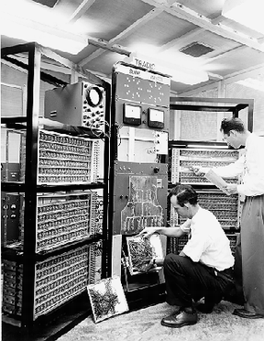

Slide 81
Second generation(1955 – 1965):
The invention of Transistors marked the start of the second generation.
Magnetic core memories and magnetic drum storage devices were more widely used in the second generation.
High level languages, such as Fortran were developed, making preparation of programs much easier.
System programs called compilers were developed to translate these high level language programs into corresponding assembly language program.
Separate I/O processors were developed that could operate in parallel with the central processor.
IBM became a major computer manufacturer during this time.

Slide 82
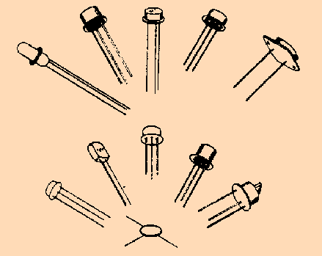

Slide 83
Third generation(1965-1975):
Third Generation Computers were based on integrated circuit (IC) technology.
Integrated circuit technology:
The ability to fabricate many transistors on a single silicon chip.
Integrated –circuit memories began to replace magnetic core memories.
Other developments included the introduction of microprogramming, parallelism, and pipelining.
Cache and virtual memories were developed.

Slide 84
Fourth generation(1975 to the present):
Fourth generation computers are based on VLSI technology.
Fabricating tens of thousands of transistor on a single silicon chip is called VLSI.
VLSI technology allowed a complete processor to be fabricated on a single chip. This became known as a microprocessor.
Portable notebook computers , desktop computers
and workstations, interconnected by local area networks.

Slide 85
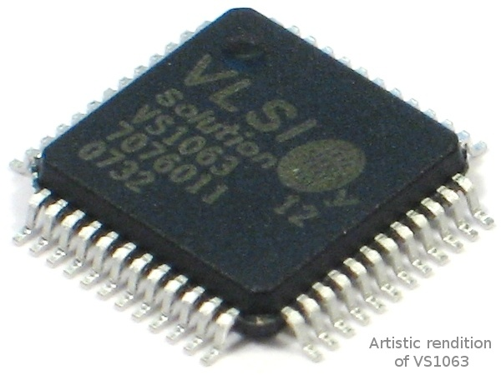

Slide 86
End of Module 1

